Slide 1
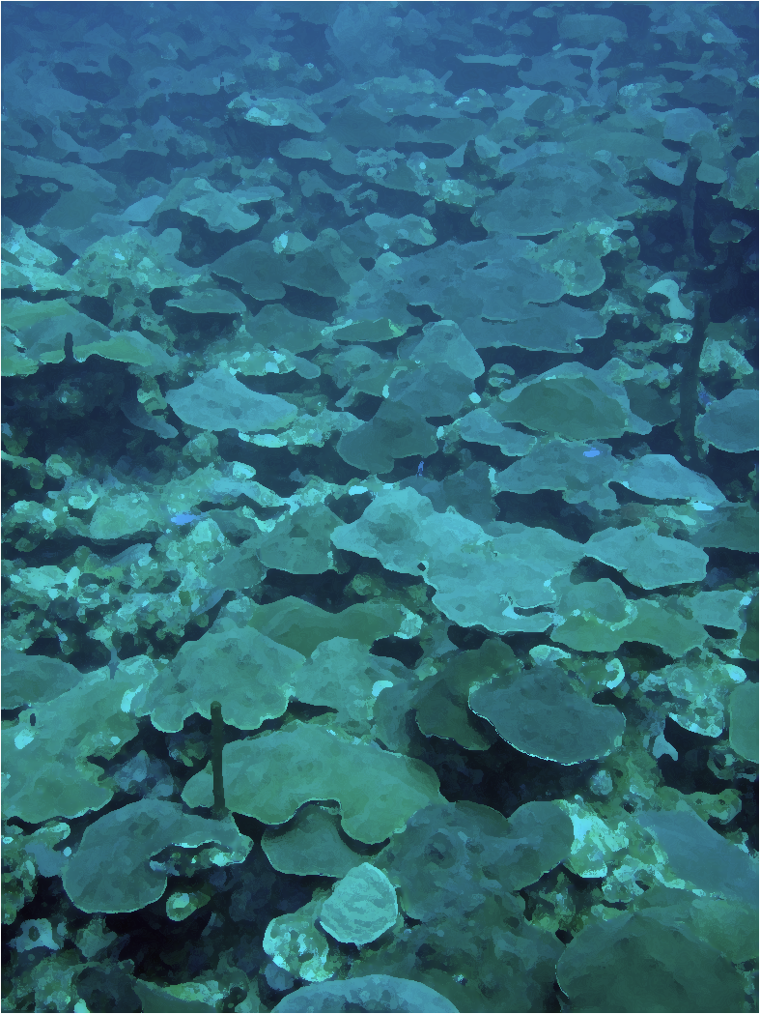
Fertility in the Fathoms
Mesophotic coral reproductive refugia and connectivity
Daniel Holstein¹, Claire B. Paris¹, Tyler B. Smith²
¹Rosenstiel School of Marine and Atmospheric Science, University of Miami ² Center for Marine and Environmental Studies, University of the Virgin Islands

Slide 2
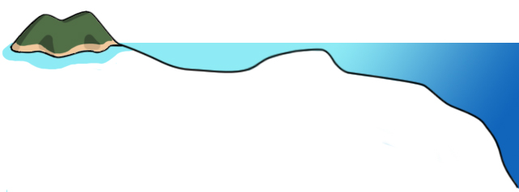
The Reef Profile
reef crest
back reef
forereef
reef slope
deep forereef
Mesophotic
zone
Adapted from Lesser et al. 2009

Slide 3
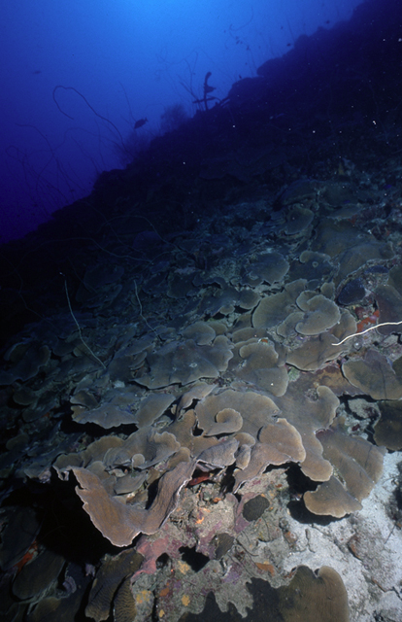
Mesophotic coral ecosystems (MCE)
Between 30-150 m depth
Light-dependent
Some knowns
Coral cover in USVI as high as 70%
Buffered from coastal and global stressors (Lesser 2004; Nemeth et al. 2008; Smith et al. 2009)
Species overlap is high in the USVI (Armstrong et al. 2006; Smith et al. 2008)
Some unknowns
Distribution, size and health
Effect of depth on coral physiology and reproduction
Photo - Mark Vermeij - www.mesophotic.org
Notes:
What do I want to say here?
Reefs between 30-100 meters
SLIDE OF REEFSLOPE

Slide 4
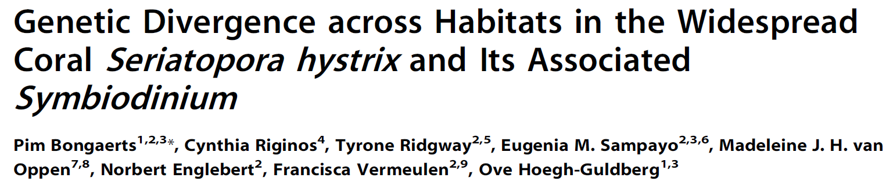
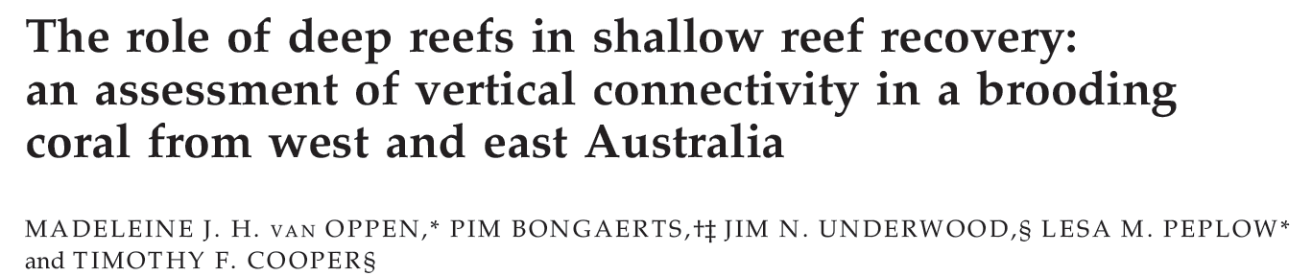
Refugia?
Lesser, Serrano and Others…
Genetic studies address historical connectivity on spatial scales restricted by sampling effort
Future shallow reefs may represent an entirely different competitive environment for mesophotic larvae

Slide 5
Questions
Deep Reef Refugia Hypothesis (DRRH)
Do mesophotic reefs contribute to processes of recovery in degraded shallow coral populations?
How does the confluence of the physical environment and biology affect vertical connectivity?
Are mesophotic corals reproducing?
  When and how much compared to shallow corals?
Notes:
The central hypothesis of this proposal is that mesophotic coral ecosystems may impart resilience to Caribbean coral populations, and possibly serve as a refuge for compromised shallow coral populations.
In order to test this hypothesis, I will use a biophysical model of larval dispersal to look at the strength and direction of connectivity pathways between shallow and deep habitats.
Now, most of the model structure has already been constructed by Claire Paris, Aswhanth Srinivasan and others. I will be parameterizing this model with empirical data and refining components of the model for my purposes.
[To do this there are four major components I am focusing on.
First, I need to investigate if deep populations are reproducing, and at what magnitudes compared to shallow populations. Magnitude of production can significantly effect the size and shape of dispersal probability distributions (Boltsman et al. 2009, Gallego and North 2009, Scott et al 2006).
initial conditions such as egg or larval rising or sinking rates and active swimming behavior affect vertical position of those particles in the water column. Studies by Paris and Cowen (2004) and Paris (2007) have shown that vertical distribution of eggs or larvae in the water column has implications to dispersal because particles are subject to differing flow-velocites, temperatures, salinities, etc. that can effect their dispersal direction and speed.
I will also need to look at mesophotic habitat boundaries, size and quality. This data will be synthesized with the previously mentioned production data to create larval production models and delineate source and recruitment nodes.
These three objectives are important pieces of novel research on their own, however I plan to synthesize them in the parameterization of a coupled biophysical dispersal and connectivity model, capable of addressing my initial hypothesis.]

Slide 6
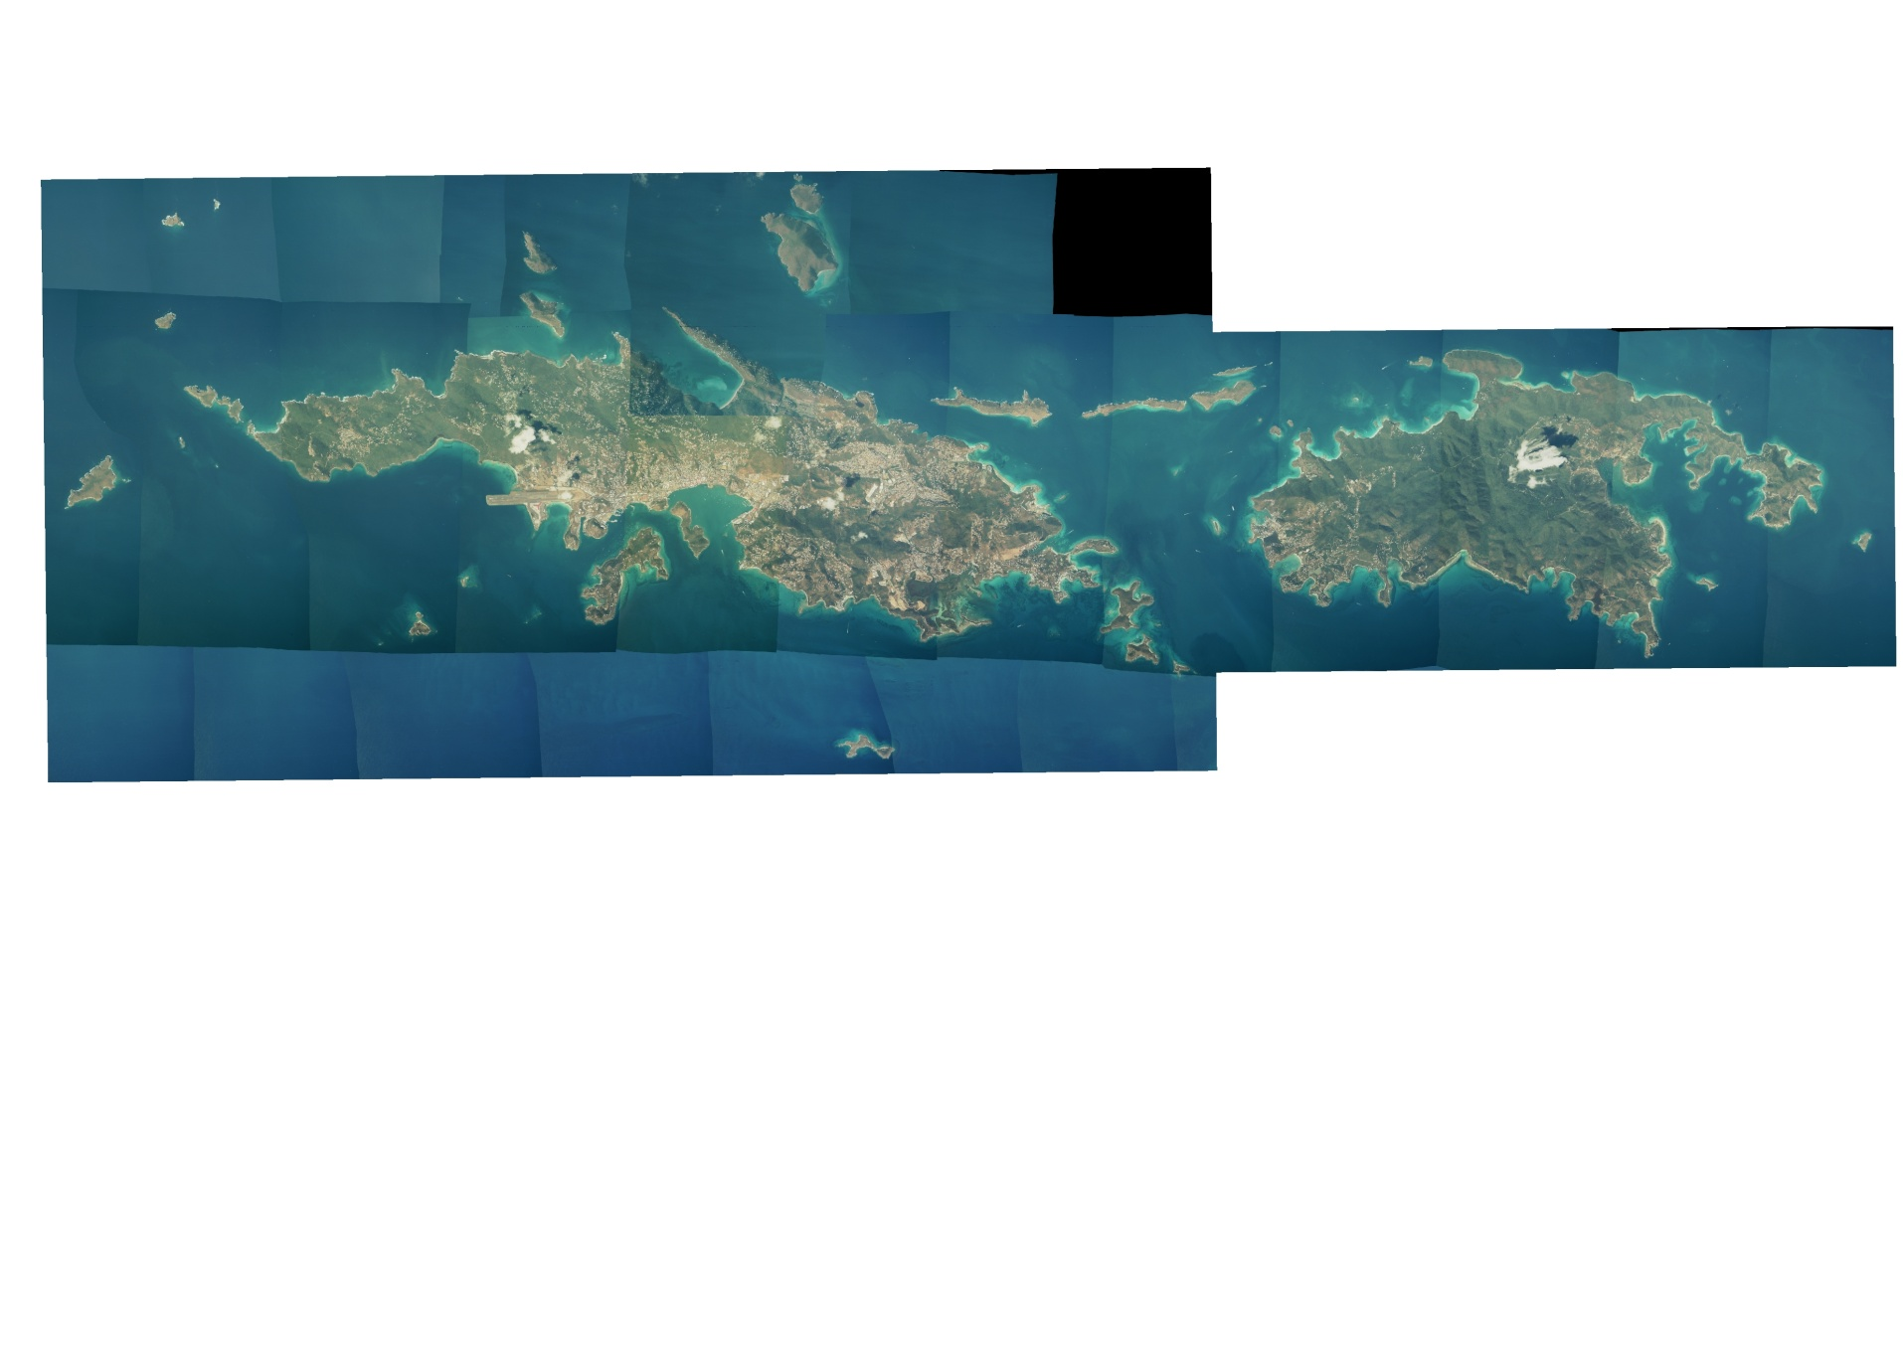
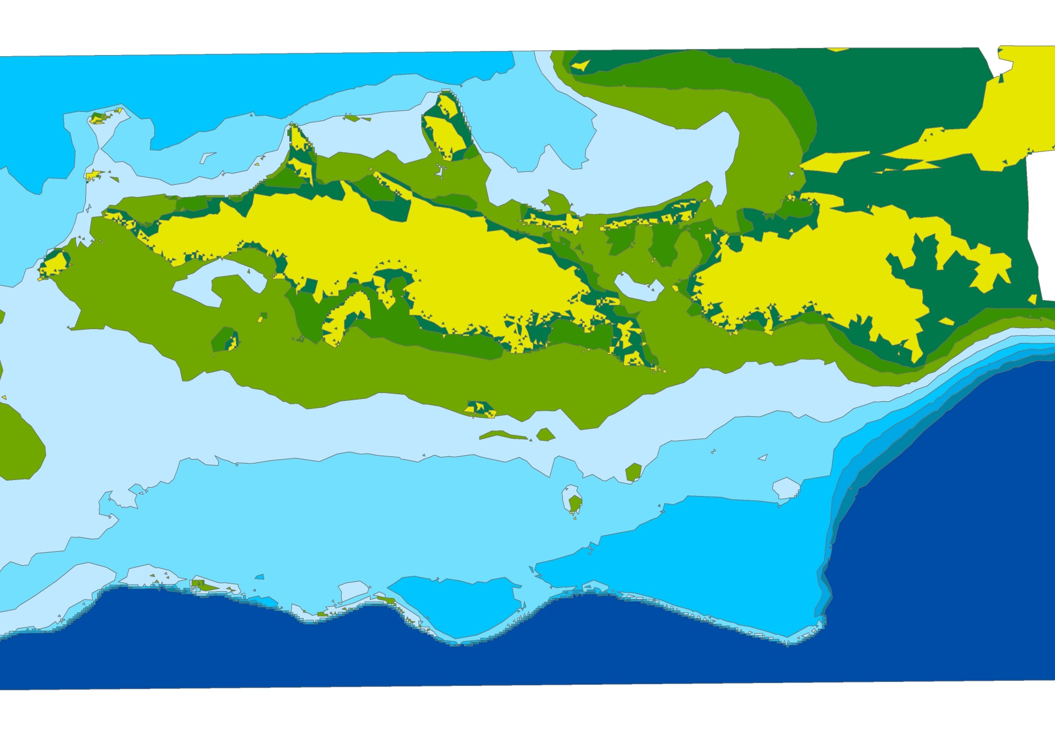
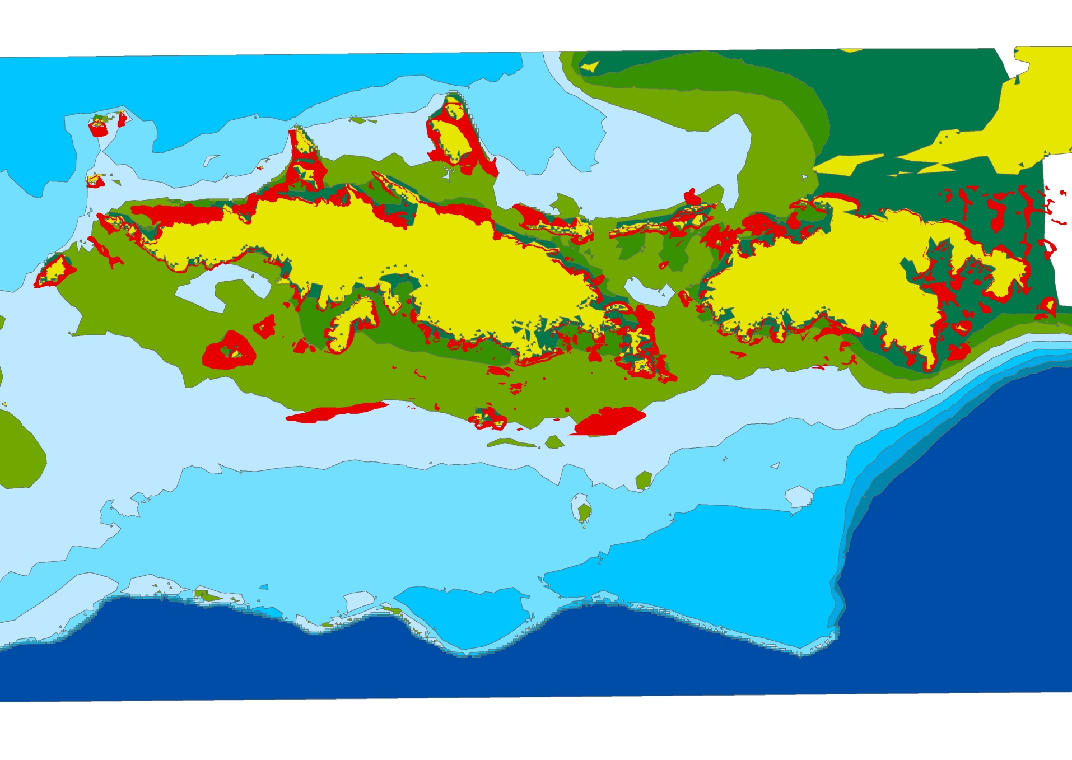
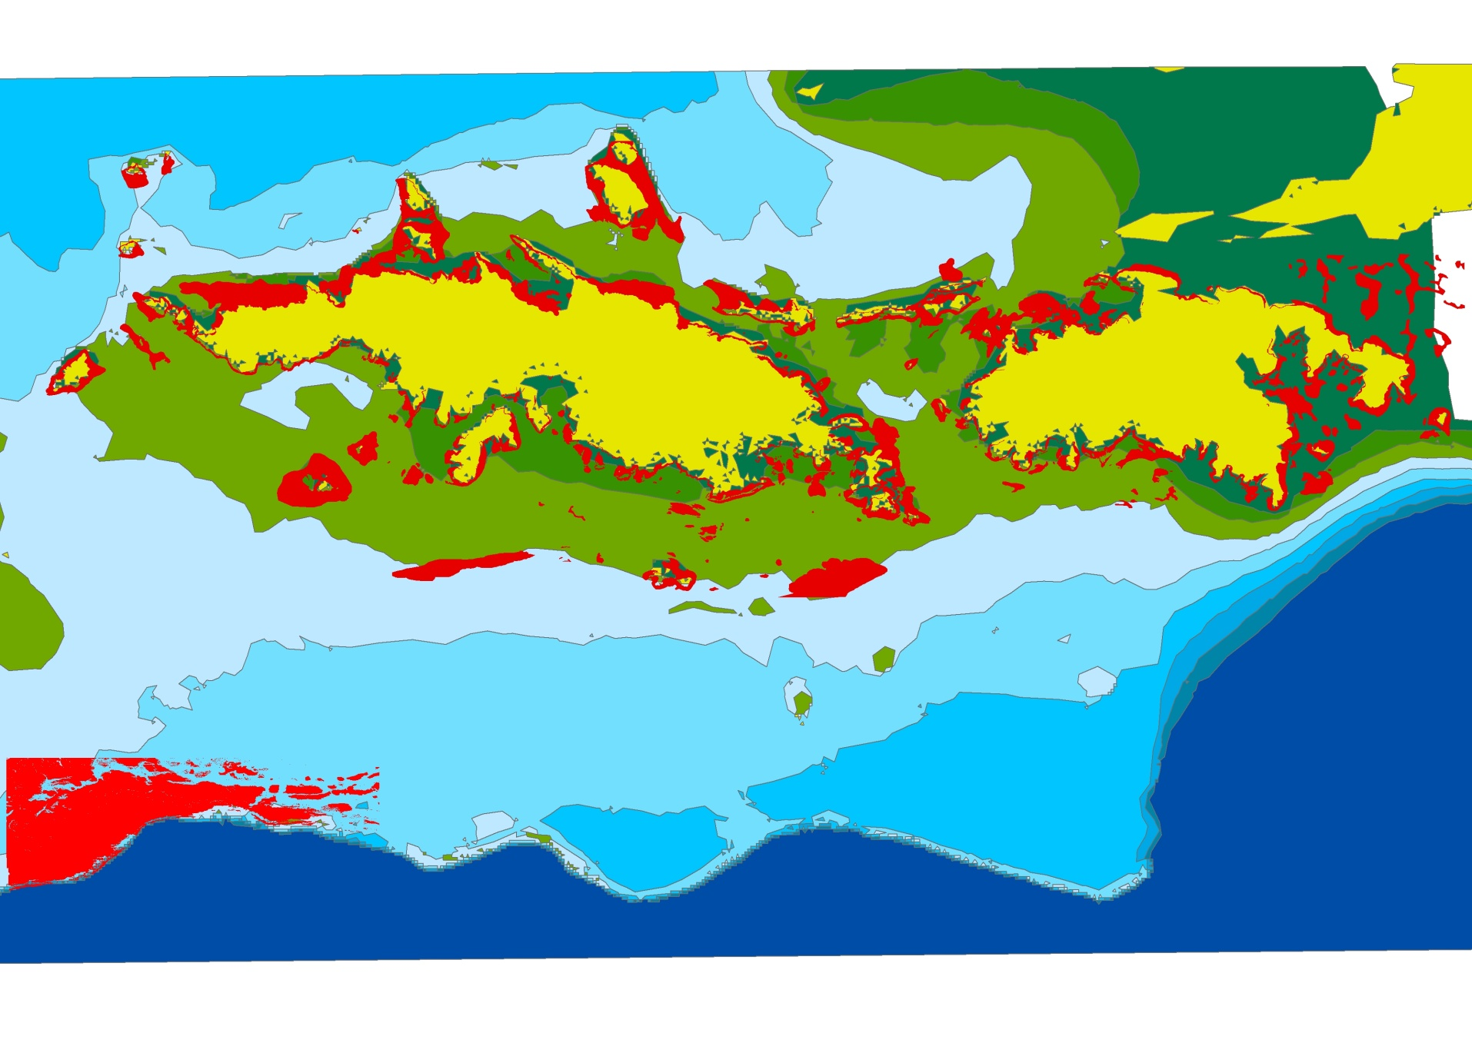
St. Thomas and St. John, USVI
NOAA Center for Coastal and Marine Assessment (CCMA)
University of the Virgin Islands Center for Marine and Environmental Studies (CMES)
Notes:
The study sites are shallow and mesophotic reefs around the islands of St. Thomas and St. John. Just to go over some of the basic characteristics of these islands and their adjacent marine environments, the islands are populated and there is extensive coastal development, especially on St. Thomas. However, there are large terrestrial and marine protected areas.
vector map
blue areas shallower than the drop off can be considered mesophotic, which means they are between 30-150 meters in depth

Slide 7
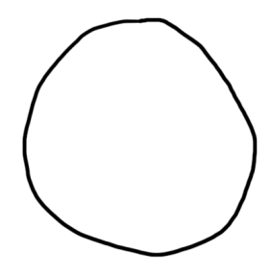
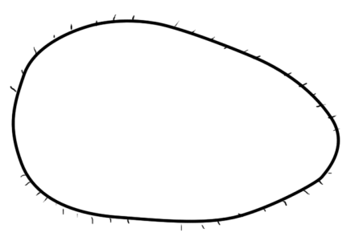
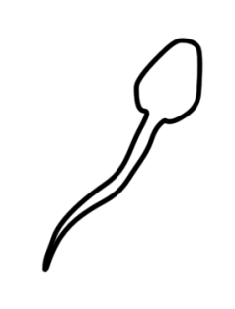
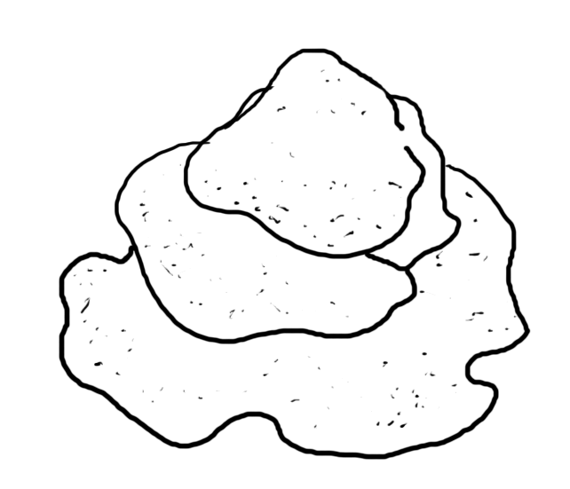
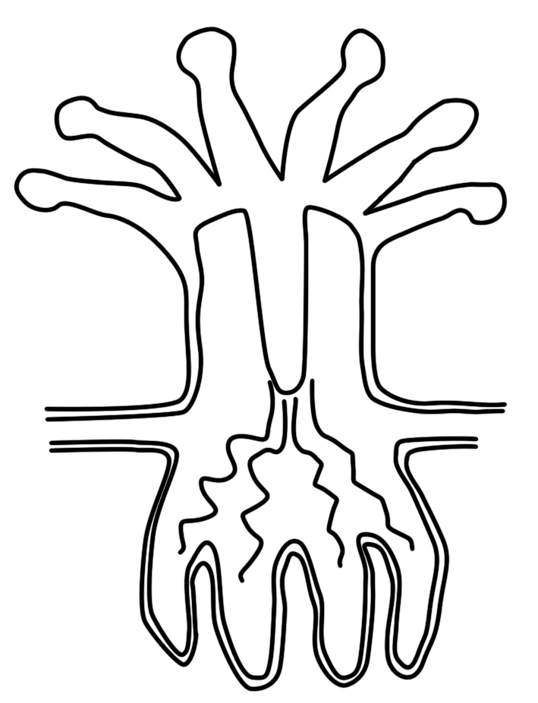
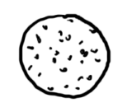
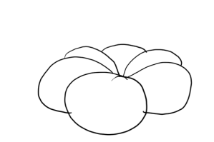
Broadcast Spawner Life Cycle
Notes:
There are two target species in this study.
They are being targeted due to their abundance and reef-building characteristics in both shallow areas and at depth, and because of their and differing sexual strategies.
reproduction info:
The two target corals have different sexual strategies. M faveolata is a simultaneously hermaphroditic broadcast spawner, and once, or possibly twice, a year colonies release egg and sperm bundles into the water column, where they float to the surface, break up, fertilize one-another and develop into planula larvae. This happens about one week after full moon in late summer. (Szmant…)
P astreoides is a brooding coral. Brooders internally fertilize eggs from sperm released into the water column and release fully developed planula larvae. Brooders like p astreoides tend to have extended reproductive seasons, and p astreoides release larvae from April until as late as September, with peak release occurring around new moons of April and May (Mcguire 1998). It is generally believed that because brooders release competent larvae, and broadcasted larvae need time to develop, that brooders have shorter dispersal probabilities than broadcasters.

Slide 8
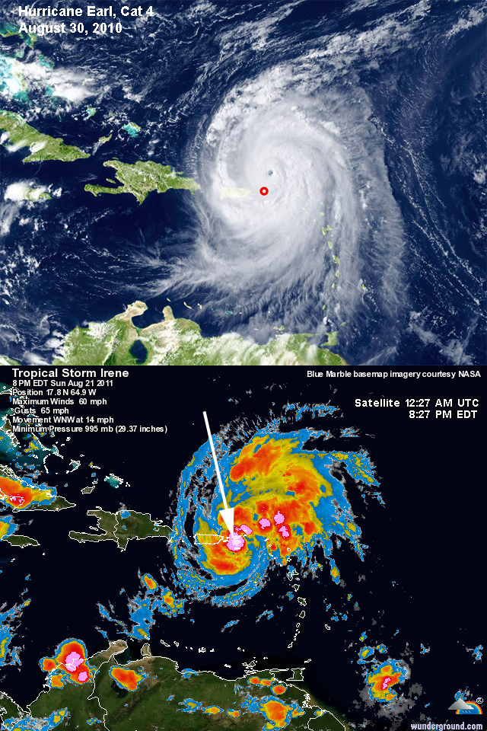
Montastraea faveolata
2008
  six sites
  one time-point pre-spawn
  ~50 samples
2010
  five sites
  one time-point pre-spawn
  ~75 samples
2011
  3 sites
  5 time-points over 5 weeks
  ~77 samples
  Analyses under way

Slide 9
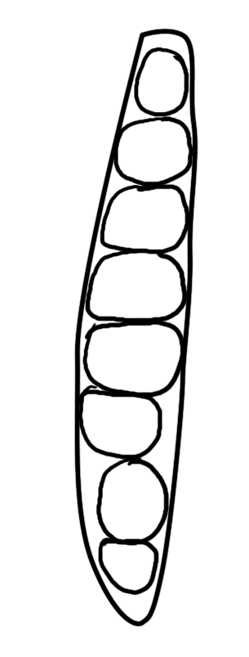
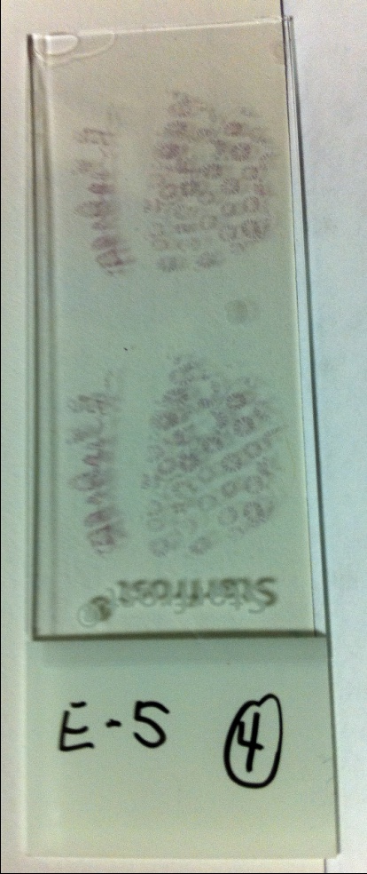

Slide 10
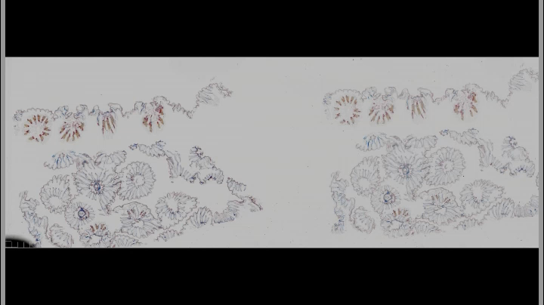

Slide 11
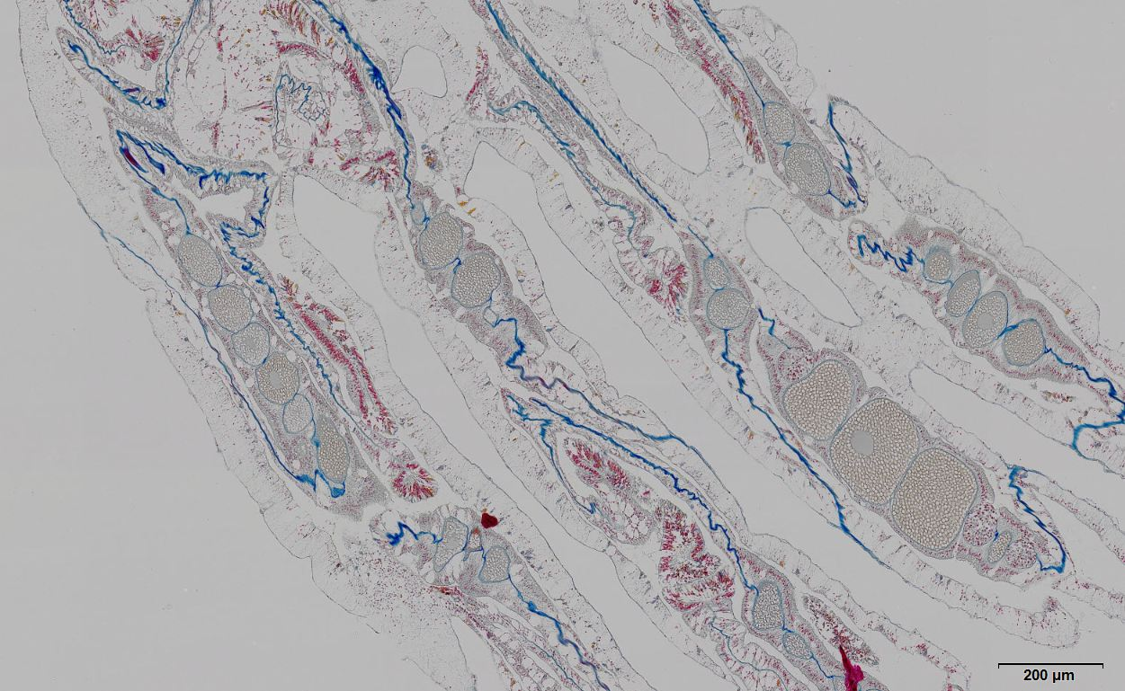
M. faveolata histology
mesoglea
oocytes
II-III
III
spermaries
II-III

Slide 12
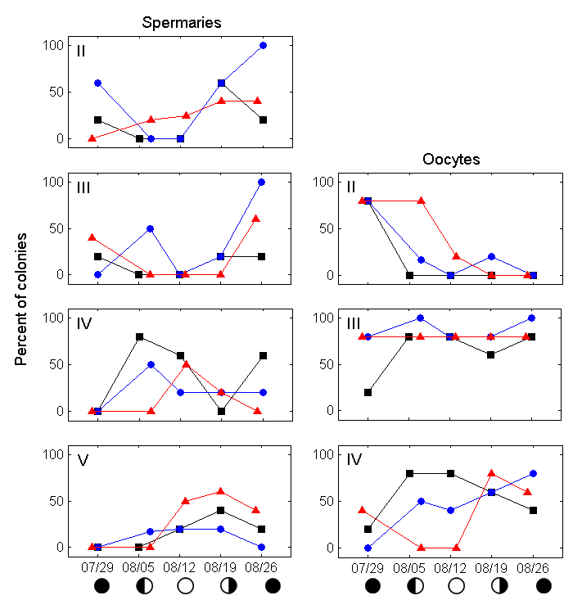
Shallow (5-10m)
Mid (16-21m)
Mesophotic (35-40m)

Slide 13
*
No difference in ova size or fecundity between 20 and 40 meters
Almost certainly more gametes of mesophotic origin in the water column
However, they may be smaller (less fit?)
**
**
Stg IV ova volume (mm³ x 10⁻²)
/
*
**
**
*
# oocyts x mes⁻¹ (long. section)
Shallow
(5-10m)
Mid
(15-20m)
Mesophotic
(35-40m)

Slide 14
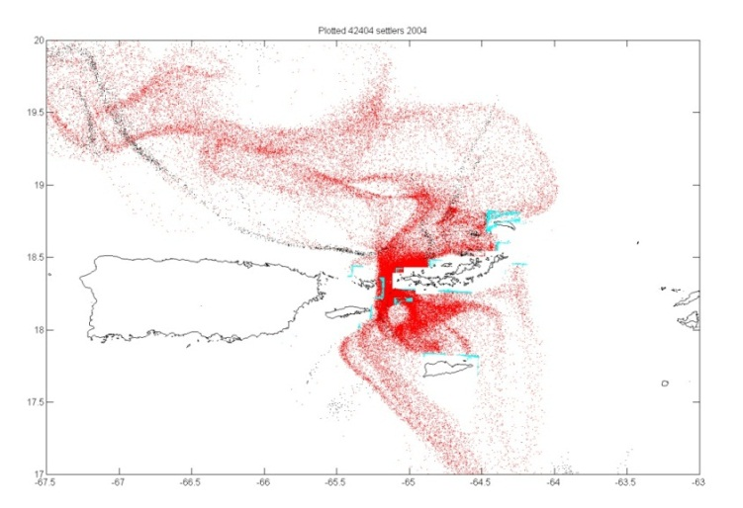
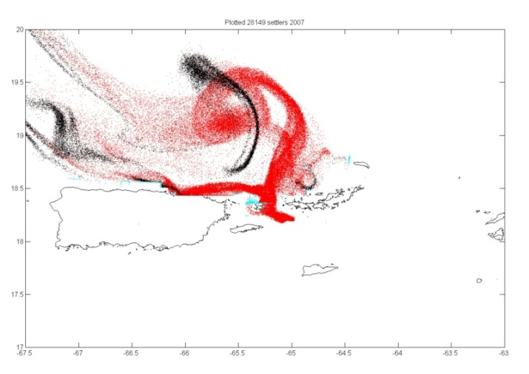
Modeling larval dispersal
IBM
Larval dispersal
Seascape
Habitat boundaries, production and settlement nodes
Oceanography
Currents (ROMS)
T/S, pH, etc. (HYCOM, Field)
Biology
Production, egg and larval behavior, habitat characteristics
The Physical-Biological Interactions Laboratory

Slide 15
Implications for DRRH
Mesophotic M. faveolata appear to be gravid on the same oogenic cycle as their shallow counterparts
MCE represent potential reproductive refugia for M. faveolata
Initial modeling suggests no physical barrier to VI mesophotic M. faveolata populations contributing larvae to shallow habitats
Notes:
Initial dispersion from mass spawning – based on observation. Not done before. (AND from mesophotic habitats)
Mesophotic areas.
Baums et al --

Slide 16
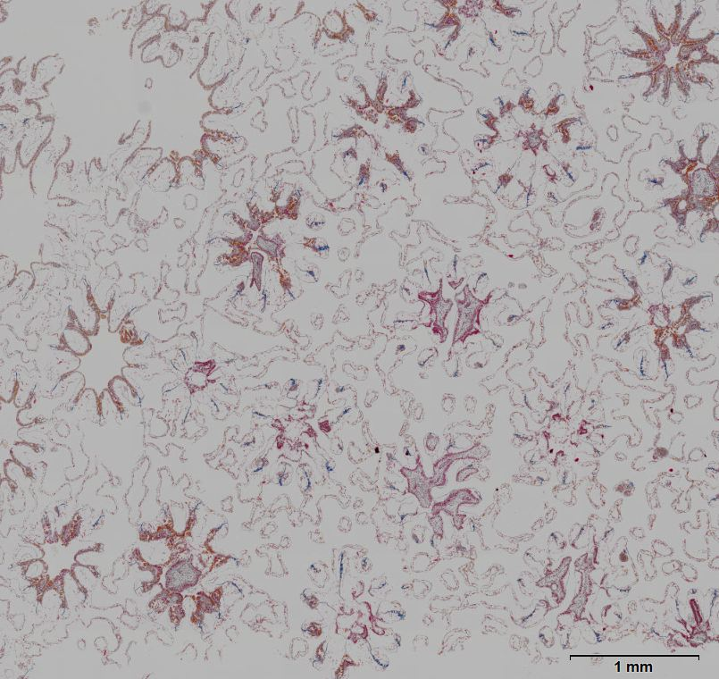
Continued work
Continued characterization of mesophotic M. faveolata reproductive and larval characteristics
Similar work on Porites astreoides
Refined and expanded modeling with high resolution habitat and oceanographic data

Slide 17
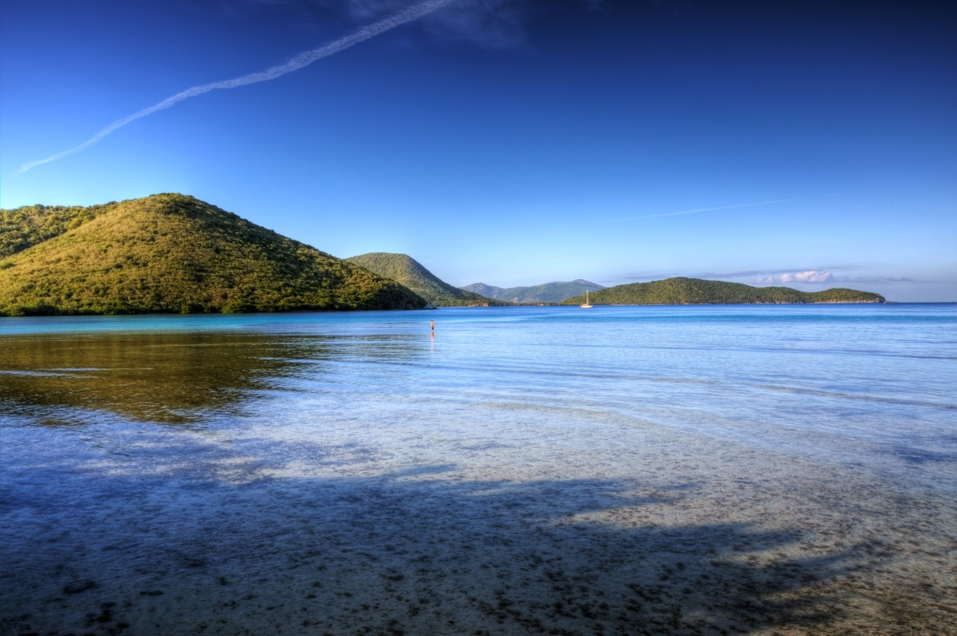

Acknowledgements
Andy Bakun
John McManus
Margaret Miller
Alison Moulding
Abby Renegar
Marilyn Brandt
Viktor Brandtneris
Erica Staaterman
Andy Kough
Cedric Guigand
Shawn Kadison
Jacqui Calnan
Leslie Henderson
Matt Kammann
Chris Loeffler
Kristine Stump
Ian Enochs
Laurent Cherubin
Funding and assistance:
RSMAS fellowship
Science Made Sensible
Fellowship (NSF)
Rowland Research Award
VI-EPSCoR (NSF)
Natural Environment
Research Council (NERC)
– Exeter University
University of the Virgin
Islands

